Slide 1
Estonian Tourism Conference Steering uptapped tourism potential to the Nordics and Baltics Mikko Turtiainen, VP Global Sales

Slide 2
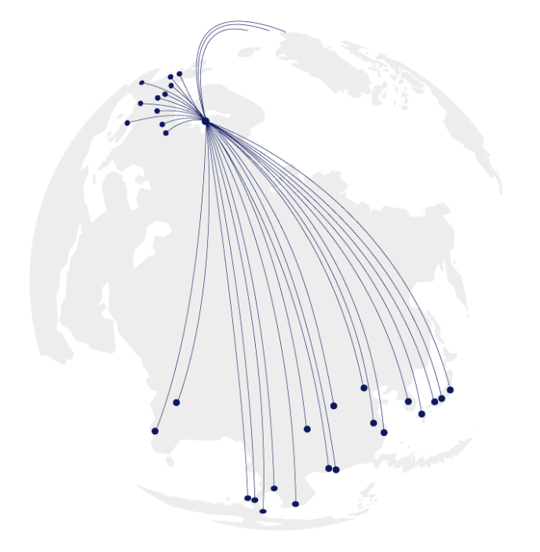
Finnair strategy
Growth
Transformation
Customer Experience
People Experience

Slide 3
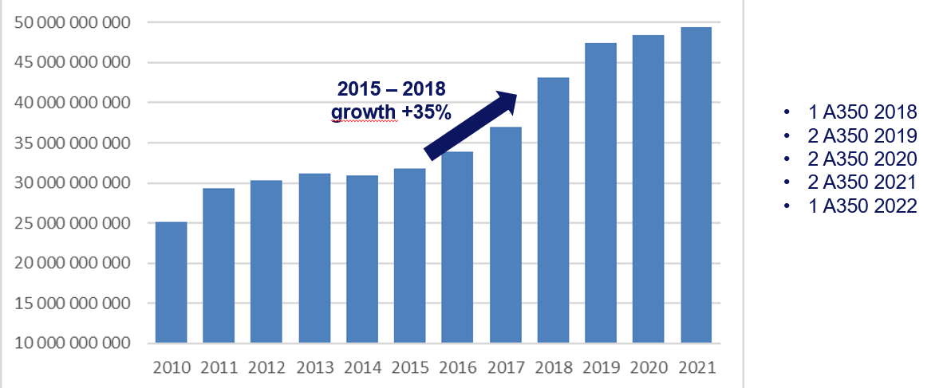
Finnair growth
11,9 million passengers during 2017

Slide 4
Travel Trends
Growth Industry
Experience travel
Wellness travel
Live like a local
Arctic
Education
Cuisine

Slide 5
How to get tourists to Nordics and Baltics Unfortunately no secret remedy, just hard work!
target markets, target segments, target channels
Knowledge of destination & service offering
Partners
Understanding the consumer / traveller
Communication

